Slide 1
Thesis Presentation
Using Software Defined Radios for radiometer applications
Matthew E. Nelson
Committee Members:
Phillip Jones
John Basart
Mani Mina
Spring 2014

Slide 2
Thesis overview
Introduction
Software Defined Radios
GNURadio Software
Current ISU Radiometer
Related Works
General theory of operation
Software Defined Radios (SDR)
GNURadio Software
RF Front end

Slide 3
Thesis overview
GNURadio and N200 TPR
Hardware
Requirements
Noise Temperature Considerations
Existing ISU Radiometer RF Front end
Software
Requirements
Obtaining signal information and GUI Controls
Implantation of a TPR in software
Data storage and Display

Slide 4
Thesis overview
Testing and Verification
Square-law Detector
SDR Tests
E E 518 Lab tests
LN2 Tests

Slide 5
Thesis overview
Performance and Evaluation
Sensitivity, Accuracy and Stability
Required Performance Requirements
Square-law Detector Performance
SDR Performance
Conclusion and Future work

Slide 6
General theory
Radiometer theory
SDR Role

Slide 7
Radiometer theory
Radiometers measure power
Specifically radiometers measure the total noise power
The total noise power measured can be converted to a noise temperature
This information can be used for remote sensing

Slide 8
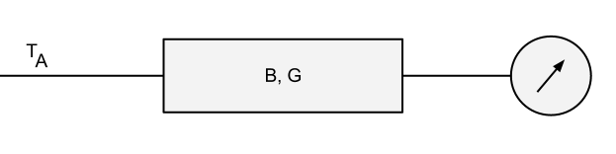
Radiometer theory
Radiometer chain
Antenna/Source
Filter
Amplify
Detect
Measure

Slide 9
Radiometer theory
Noise consideration
Each component will add unwanted noise
Steps are taken to minimize
Low Noise Amplifiers (LNAs)
Low noise figures on components

Slide 10
Radiometer theory
Stability
A radiometer must be stable
Different methods for achieving this
Dicke Radiometer
ISU Radiometer
Precise temperature control
We assume our source is stable

Slide 11
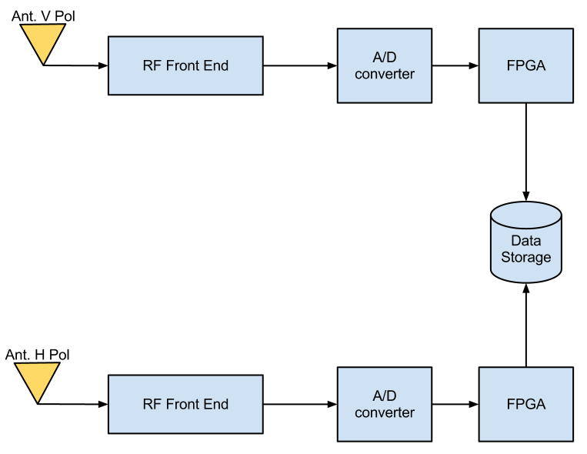
SDR Role
Current ISU Radiometer

Slide 12
SDR Role
Current ISU Radiometer
Directly digitizes the signal
A/D Under samples the information
Can only recover power information
No spectrum information is preserved
Is currently not functioning
Issues with the FPGA

Slide 13
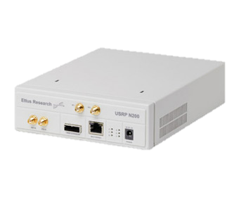
SDR Role
SDR replacement
Replaces current A/D and FPGA
Off the shelf component
Standard equipment
Open source firmware and software
Smaller package

Slide 14
SDR Role
N200 uses the DBSRX2 daughterboard
800 MHz to 2.4 GHz
~ NF of 5 dB (626 K)
~ NF of 3.67 dB (~ 385 K)
This includes antenna and all filters and LNAs
Data provided by University of Michigan
Total amplification of 71.4 dB
FGPA
1.8 Million gates
32-bit RISC processor
N200
DBSRX2
A/D
FPGA
Amplification and filtering
Power Divider
DBSRX2
A/D
A/D Converter
100 Mbps 14-bit
Square-Law Detector
PIC32
PC
GNURadio
Data
Storage
Square Law
-60 to 1 dBm
PIC32
Up to 80 MHz operation
10-bit A/D
I2C, SPI, 4xUARTs
512K FLASH
Matlab
Python Datalogger

Slide 15
SDR Role
GNURadio implements a radiometer in software
Digital Square-Law
Filter and integration
This information is saved for later analysis
Raw IQ values
Total Power values
Spectral information

Slide 16
SDR Role
GNURadio allows us to control the system
Frequency
Gain
Within the SDR
Bandwidth (Sample time)
Integration time

Slide 17
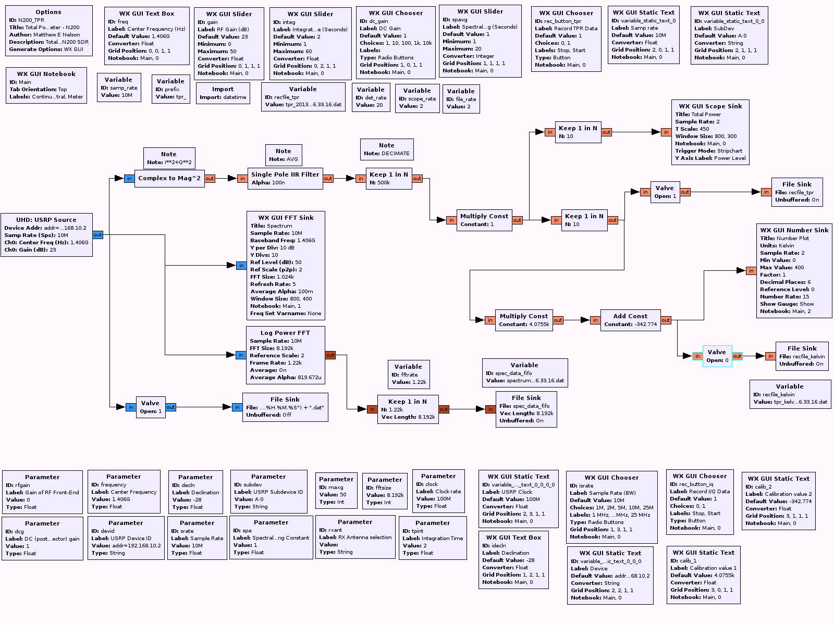
SDR Role

Slide 18
SDR Role
GNURadio Receives IQ data from source
N200 SDR
Simulated Noise Source
Recorded IQ values

Slide 19
SDR Role
Software square-law detector
Squares and sums the values
Takes in complex value
Outputs a float value
Replaces a typical Square-law detector

Slide 20
SDR Role
Software Low Pass Filter
Smooth out data
Acts as our integrator
Integration time sets Alpha values

Slide 21
SDR Role
Decimation
Reduces sample rate
Does not affect bandwidth
Reduces CPU requirements

Slide 22
SDR Role
Output
Display data in real-time (ticker tape fashion)
Stores data in a file
“valve” allows for turning on/off recording

Slide 23
SDR Role
Calibration
Pre-calculated points can be entered
Allows data to be displayed as a noise temperature

Slide 24
SDR Role
GUI Interface
Allows for control of most SDR functions
Allows for data input
Allows for graphing and data output

Slide 25
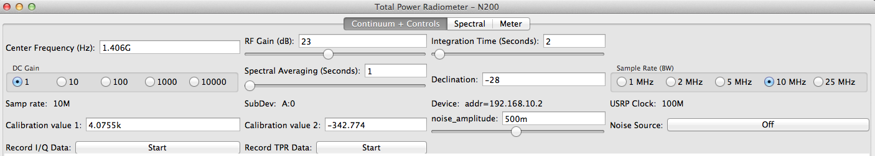
SDR Role
SDR Control
Set Frequency
Adjust gain in SDR

Slide 26
SDR Role
SDR Control
Sample Rate or BW
High BW results in higher CPU and Disk I/O
Is somewhat limited by RF Frontend

Slide 27
SDR Role
SDR Control
Integration time on IIR Filter
Defaults to 2 seconds

Slide 28
SDR Role
SDR Control
Artificial gain
Simple multiplication to the digital data

Slide 29
SDR Role
SDR Control
Calibration values
Allows for data to be displayed as a noise temperature

Slide 30
SDR Role
SDR Control
Inject simulated noise
Adjust the amplitude of the simulated source

Slide 31
Research Infrastructure
Verify SDR results
Square-law detector used
These are traditionally used in analog radiometers

Slide 32
Square-law system
Square-Law Detector
PIC32
RF Signal
Square-Law Detector
RF Signal

Slide 33
Square-law system
Sanity check
Traditional radiometer
Analog signal feed to 10-bit A/D on PIC32
10-bit resolution means we have a resolution of ~ .3 K
Assuming a 0-313 K range of temperatures
Data is sent from PIC32 to Host PC
Serial data interface
Currently uses an xBee to wireless transmit
Python script records data and timestamps it

Slide 34
Infrastructure Testing
Two files are saved to disk
GNURadio data (Binary INT16 File)
Square-law from PIC32 (ASCII/CSV File)
ASCII/CSV file is human readable
GNURadio file is not, requires program
A Matlab script can read both

Slide 35
Infrastructure Testing
Sample test
N200
Signal Generator
.dat file
.csv file
Matlab Script
Square Law

Slide 36
Infrastructure Testing
Sample test
Signal generator at 850 MHz
Due to power divider used
Power divider splits signal
Approx. 6-7 dB loss
Due to outside of divider range (200-500 MHz)
Signal recorded on both

Slide 37

Infrastructure Testing
Results – Youtube videos

Slide 38
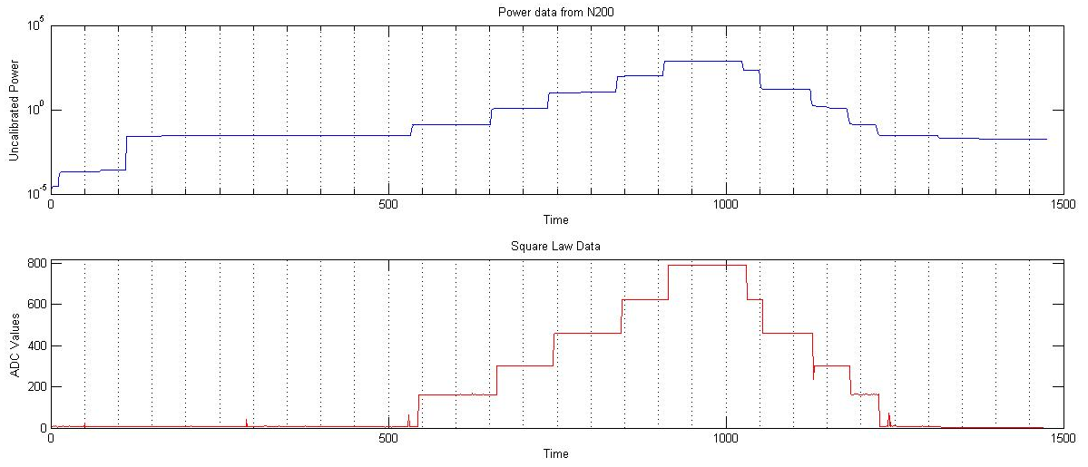
Infrastructure Testing

Slide 39
Infrastructure Testing
Results
SDR has a slighter higher sensitivity than the square law
The system is able to record both sets of data and using a Matlab script we can analyze both sets of data

Slide 40
LN2 testing
Liquid Nitrogen (LN2) is used to test the ability of the radiometer to detect a wide range of noise temperatures
A 50-ohm load is submerged into a LN2 bath
The results are then recorded by the SDR
This also allows us to calibrate the radiometer with known temperatures

Slide 41
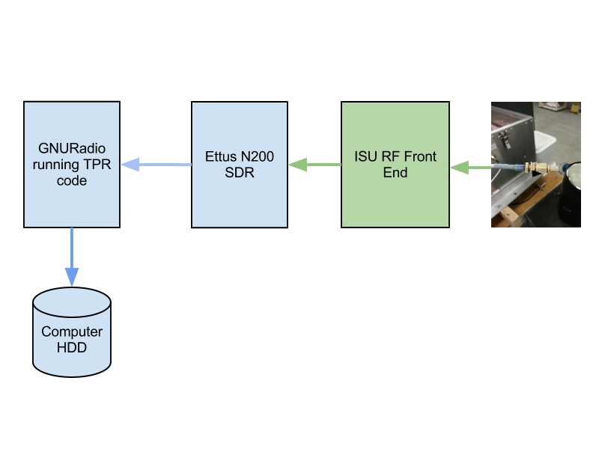
LN2 testing

Slide 42
LN2 testing
Once two points were obtained, we solved for the two unknowns
These calibration points can then be entered into GNURadio
GNURadio can now output data as a noise temperature in K

Slide 43
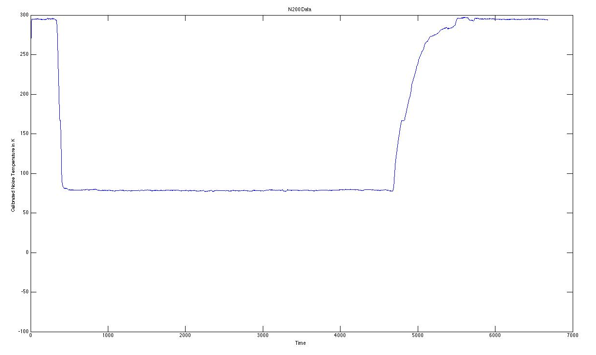
LN2 testing

Slide 44
Theory on operation
In a Software Defined Radio, we represent the signal by the amplitude (I) and the phase (Q) of the signal.
By combining these values, we can recreate the signal.
The MAX2112 directly converts the RF signal to analog I and Q values
This is then sampled and sent to GNURadio

Slide 45
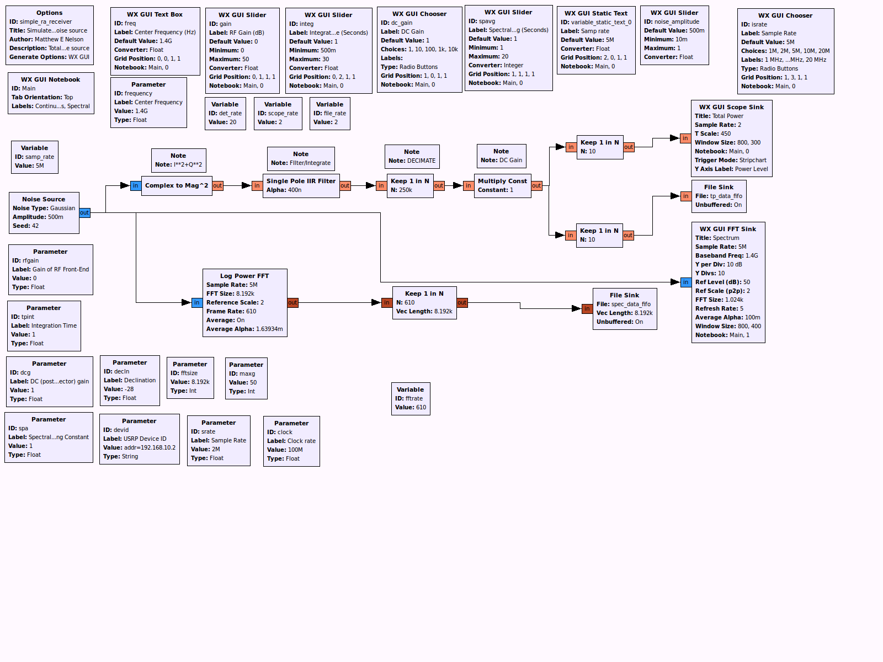
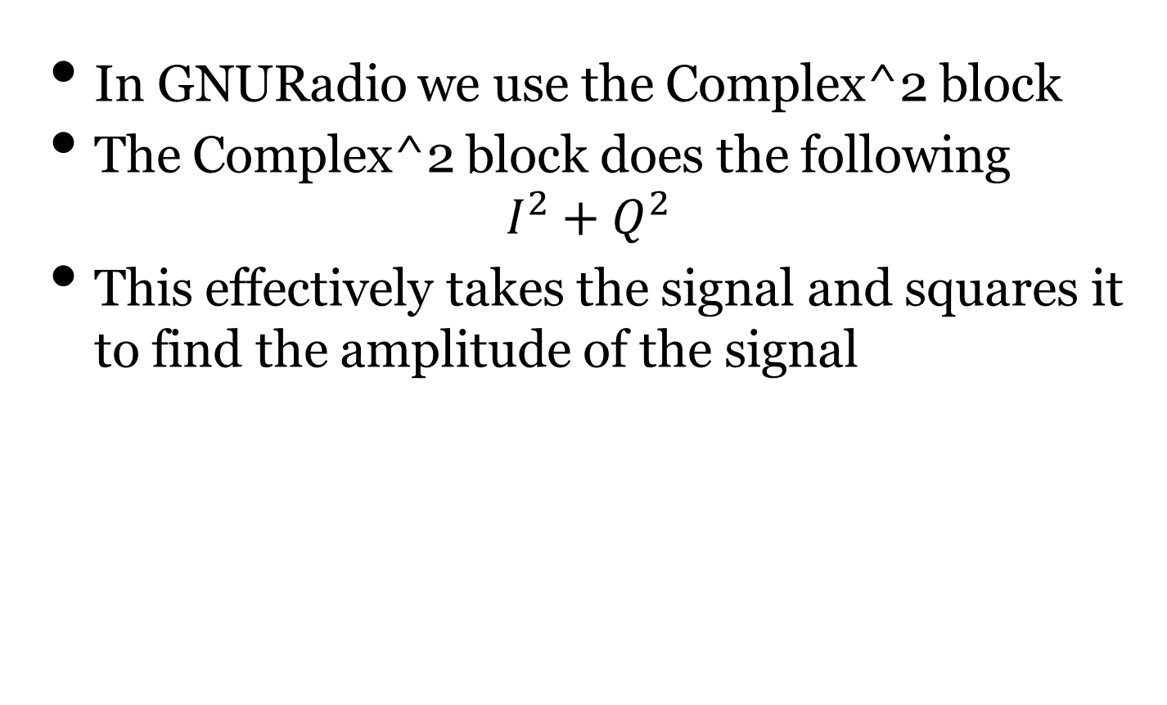
Theory on operation
In GNURadio we use the Complex^2 block
The Complex^2 block does the following
$$I^{2}+Q^{2}$$
This effectively takes the signal and squares it to find the amplitude of the signal

Slide 46
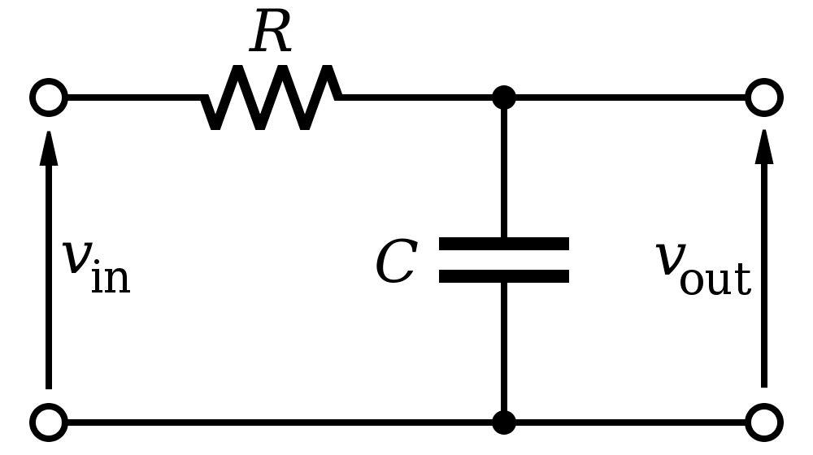
Theory on operation
As mentioned before, the raw data from the square of the signal will be erratic
We want to filter and smooth this data
We also want to integrate the signal as well
A very common filter in the analog world is a RC filter, which also acts as an integrator

Slide 47
Theory on operation
But how do we do an RC filter in the digital domain?
We use an IIR Filter

Slide 48
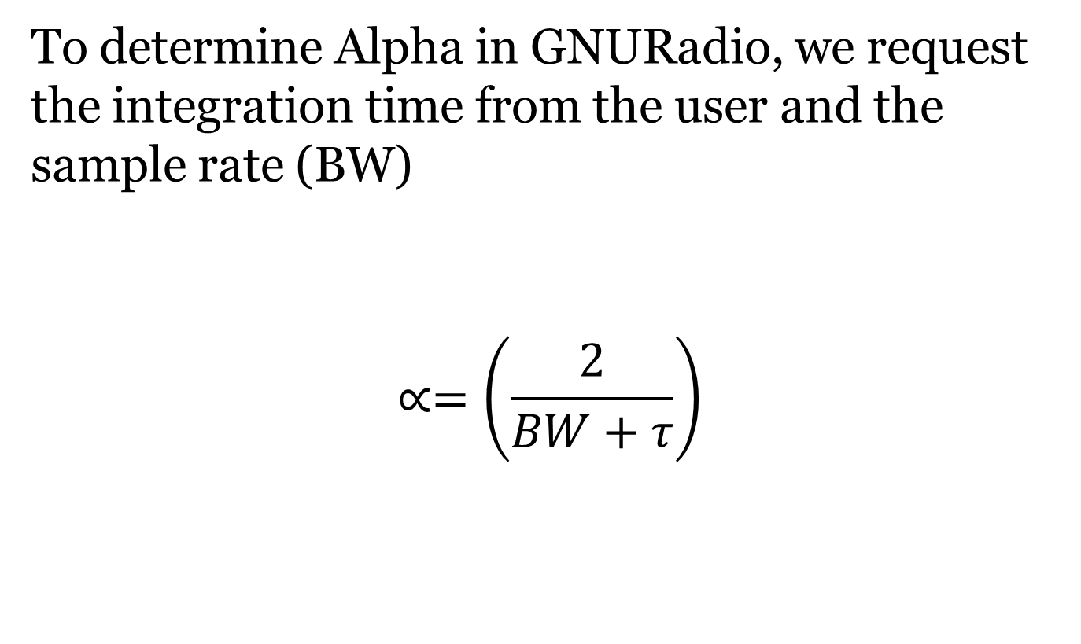
Theory on operation
To determine Alpha in GNURadio, we request the integration time from the user and the sample rate (BW)
$$∝=\left(\frac{2}{BW+τ}\right)$$

Slide 49
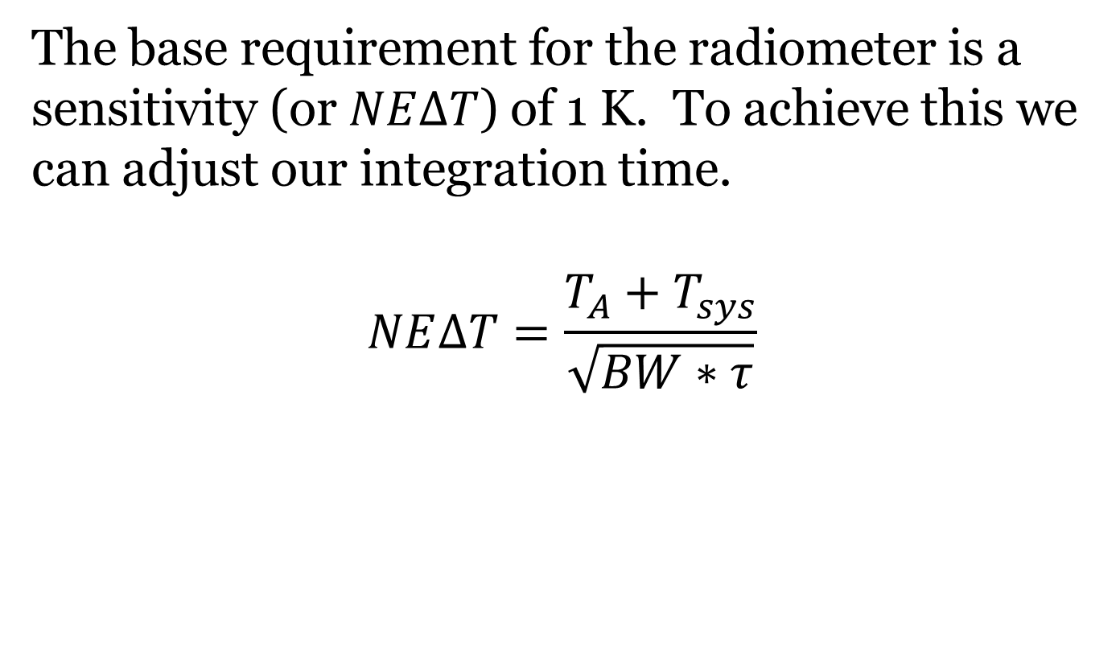
Theory on operation
The base requirement for the radiometer is a sensitivity (or $NE∆T$) of 1 K. To achieve this we can adjust our integration time.
$$NE∆T=\frac{T_{A}+T_{sys}}{\sqrt{BW∗τ}}$$

Slide 50
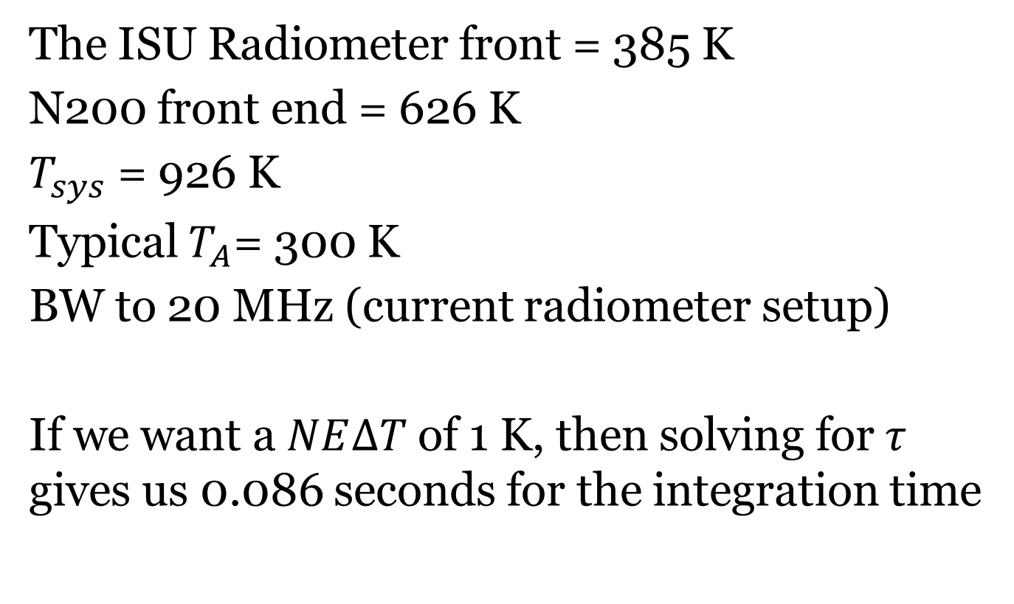
Theory on operation
The ISU Radiometer front = 385 K
N200 front end = 626 K
$T_{sys}$ = 926 K
Typical $T_{A}$= 300 K
BW to 20 MHz (current radiometer setup)
If we want a $NE∆T$ of 1 K, then solving for $τ$ gives us 0.086 seconds for the integration time

Slide 51
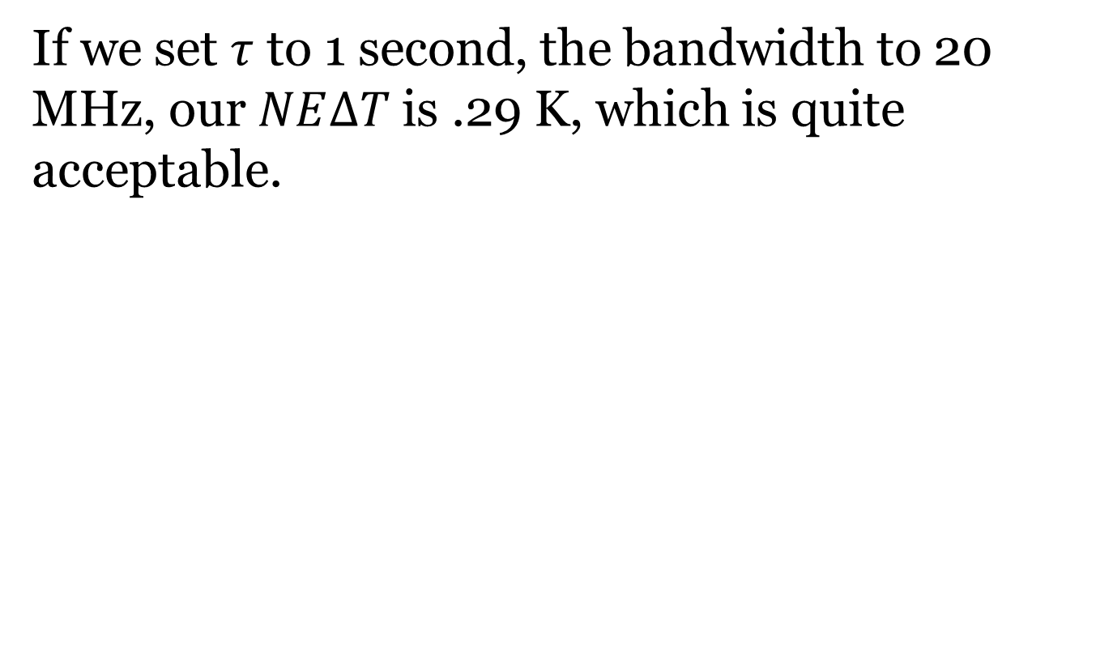
Theory on operation
If we set $τ$ to 1 second, the bandwidth to 20 MHz, our $NE∆T$ is .29 K, which is quite acceptable.

Slide 52
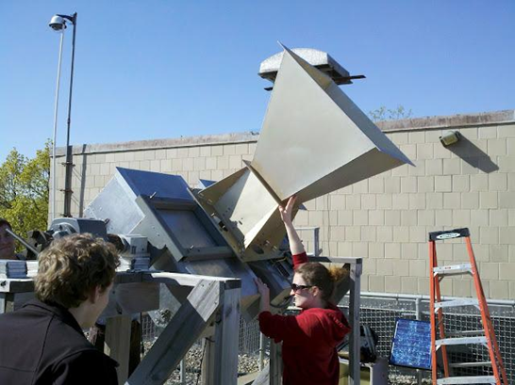
EE 518 Lab
Experiment
Radiometer rotated up to the sky
Rotated at set angels and data recorded
Repeated and changed states (Ref. load, noise diode, Antenna)
Also did a continuous sweep from 180 to 0
Day was a clear sunny day
Plate temperature was constant 293 K

Slide 53
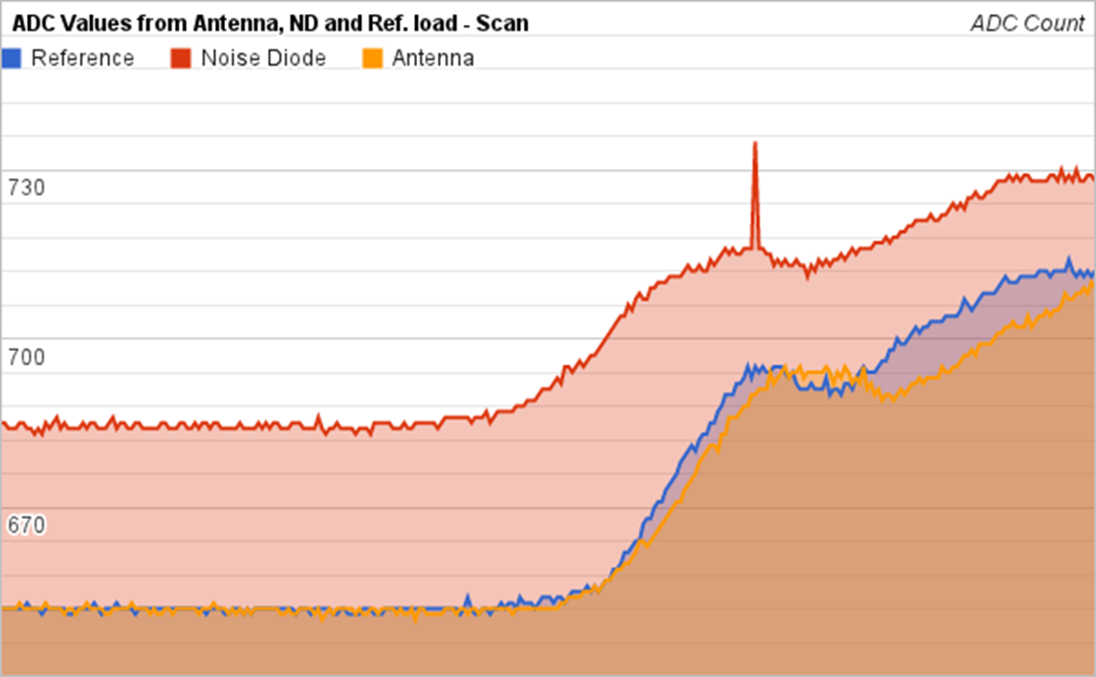
EE 518 Lab

Slide 54
EE 518 Lab
The reference load should be consistent, instead it varied as the radiometer moved
Reference load and antenna data was almost identical
This leads us to believe the switch was not working correctly
There appears to be a change in gain as the radiometer moves
The temperature increased with the noise diode turned on, as expected
Spike in the data however is disturbing

Slide 55
Future Work
Tweaks to GNURadio interface
Refinements to control
Self-calibration
Integration of square-law detector
Inject data into GNURadio
Integration to other radiometer systems
Temperature control
Switching noise diode

Slide 56
Future Work
Add correlation
Further testing with two DBSRX2 modules

Slide 57
Radiometer Refit
RF Front End needs re-work
New LNAs
Fix interference issue
Power Sub-System
Adjust for new LNAs
Adjust for new digital HW
New microcontroller
PIC32 integration
Control TECs
Read in temperature sensors

Slide 58
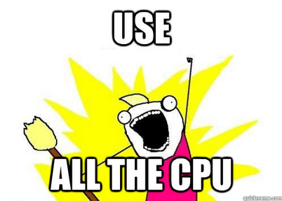
Extras
Extra slides

Slide 59
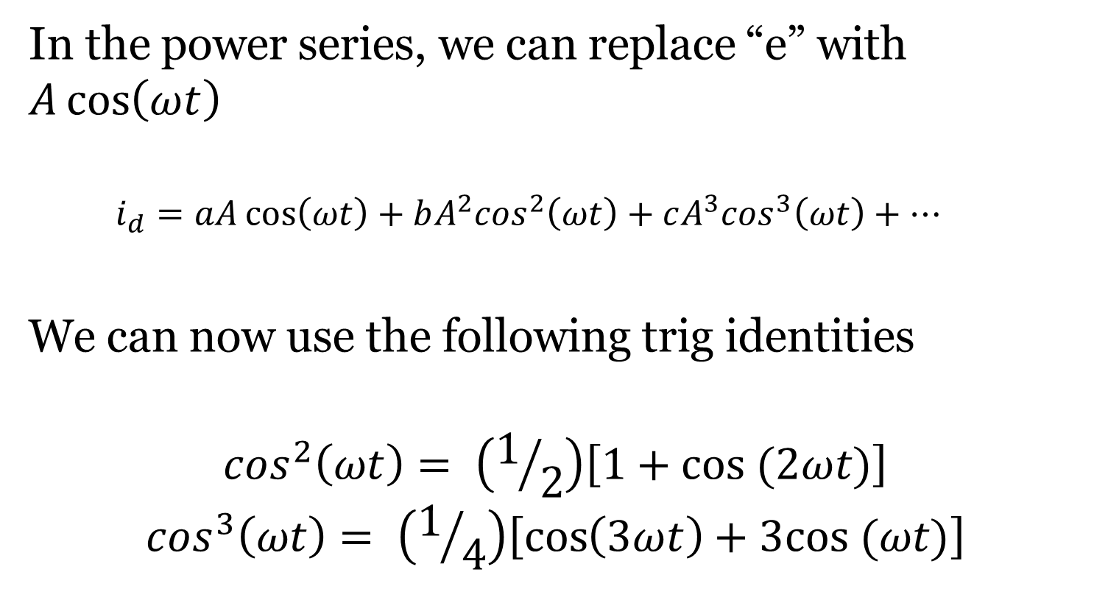
Theory on operation
In the power series, we can replace “e” with $A\cos\left(ωt\right)$
$$i_{d}=aA\cos\left(ωt\right)+bA^{2}\cos^{2}\left(ωt\right)+cA^{3}\cos^{3}\left(ωt\right)+⋯$$
We can now use the following trig identities
$$\cos^{2}\left(ωt\right)= \left(1/2\right)\left[1+cos (2ωt)\right]$$
$$\cos^{3}\left(ωt\right)= \left(1/4\right)\left[\cos\left(3ωt\right)+3cos (ωt)\right]$$

Slide 60
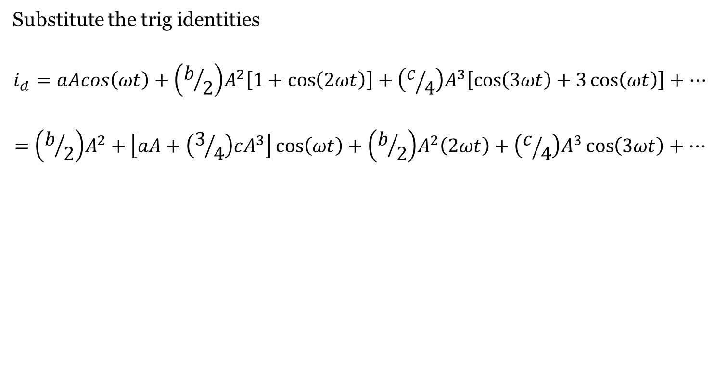
Theory on operation
Substitute the trig identities
$$i_{d}=aAcos\left(ωt\right)+\left(b/2\right)A^{2}\left[1+\cos\left(2ωt\right)\right]+\left(c/4\right)A^{3}\left[\cos\left(3ωt\right)+3\cos\left(ωt\right)\right]+⋯$$
$$=\left(b/2\right)A^{2}+\left[aA+\left(3/4\right)cA^{3}\right]\cos\left(ωt\right)+\left(b/2\right)A^{2}\left(2ωt\right)+\left(c/4\right)A^{3}\cos\left(3ωt\right)+⋯$$

Slide 61
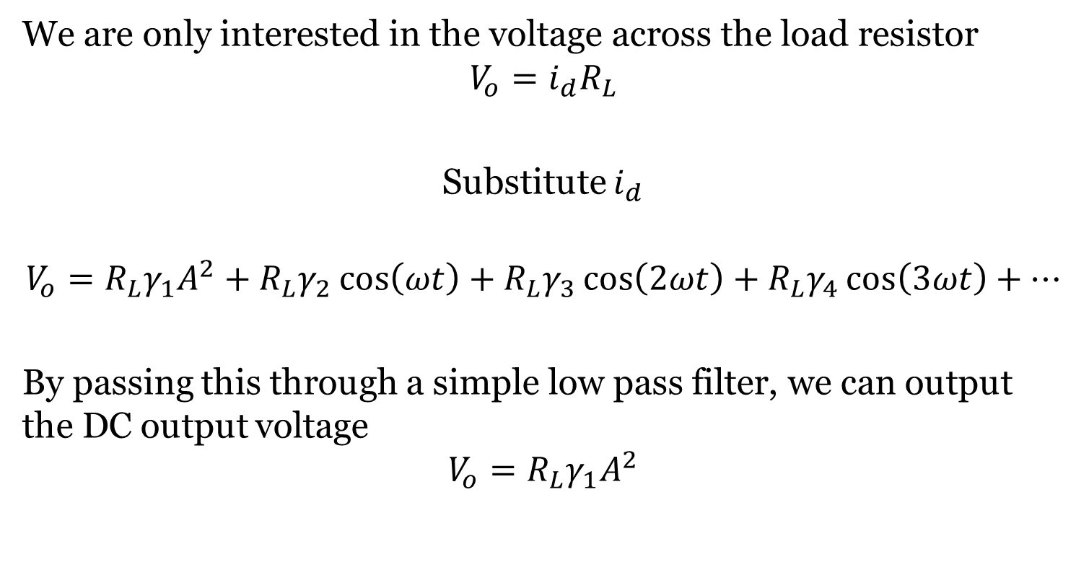
Theory on operation
We are only interested in the voltage across the load resistor
$$V_{o}=i_{d}R_{L}$$
Substitute $i_{d}$
$$V_{o}=R_{L}γ_{1}A^{2}+R_{L}γ_{2}\cos\left(ωt\right)+R_{L}γ_{3}\cos\left(2ωt\right)+R_{L}γ_{4}\cos\left(3ωt\right)+⋯$$
By passing this through a simple low pass filter, we can output the DC output voltage
$$V_{o}=R_{L}γ_{1}A^{2}$$

Slide 62
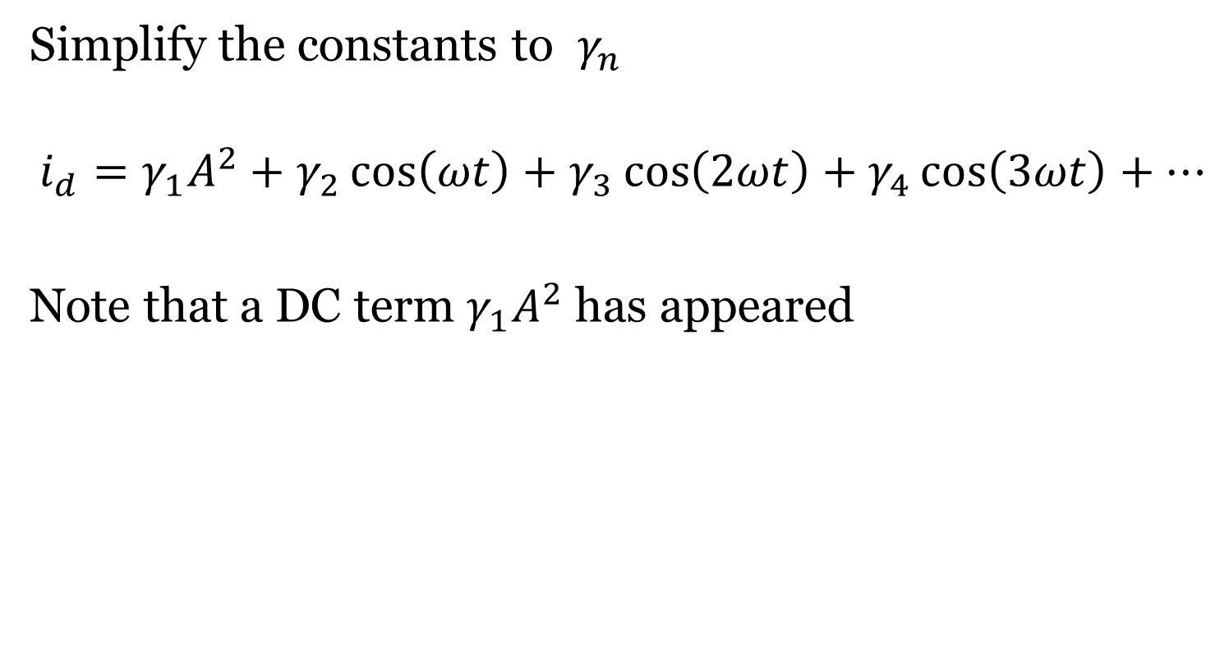
Theory on operation
Simplify the constants to $γ_{n}$
$$i_{d}=γ_{1}A^{2}+γ_{2}\cos\left(ωt\right)+γ_{3}\cos\left(2ωt\right)+γ_{4}\cos\left(3ωt\right)+⋯$$
Note that a DC term $γ_{1}A^{2}$ has appeared

Slide 63
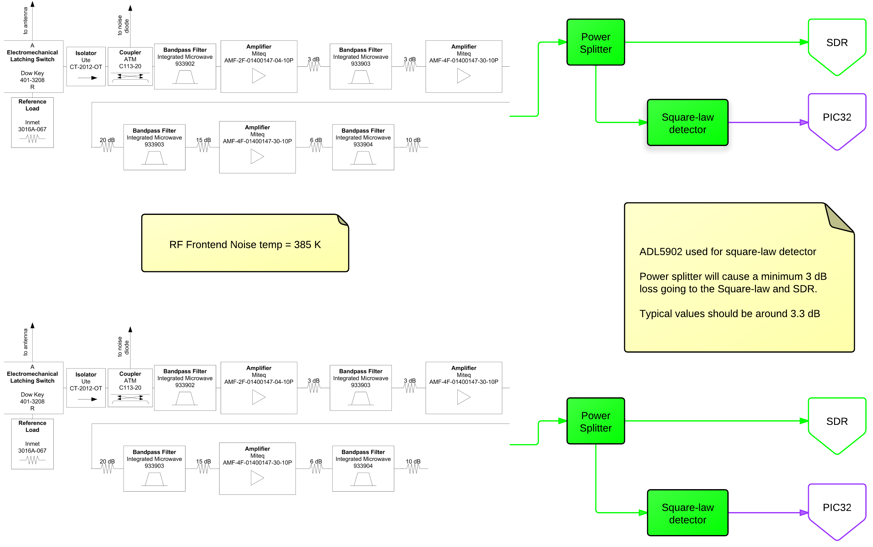
Research Infrastructure

Slide 64
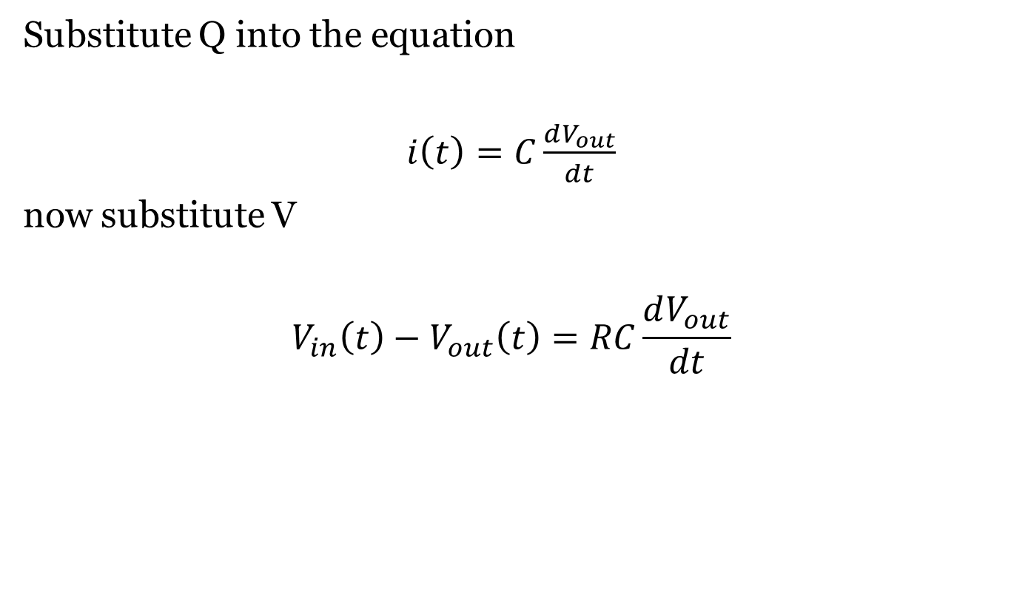
Theory on operation
Substitute Q into the equation
$i\left(t\right)=C\frac{dV_{out}}{dt}$
now substitute V
$$V_{in}\left(t\right)−V_{out}\left(t\right)=RC\frac{dV_{out}}{dt}$$

Slide 65
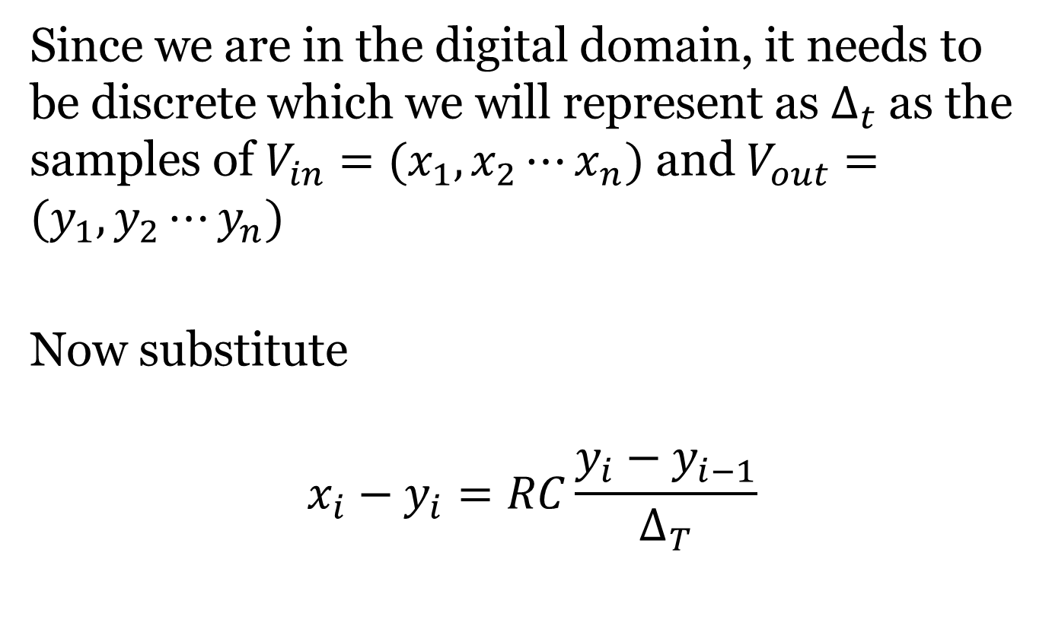
Theory on operation
Since we are in the digital domain, it needs to be discrete which we will represent as $∆_{t}$ as the samples of $V_{in}=(x_{1},x_{2}⋯x_{n})$ and $V_{out}=(y_{1},y_{2}⋯y_{n})$
Now substitute
$$x_{i}−y_{i}=RC\frac{y_{i}−y_{i−1}}{∆_{T}}$$

Slide 66
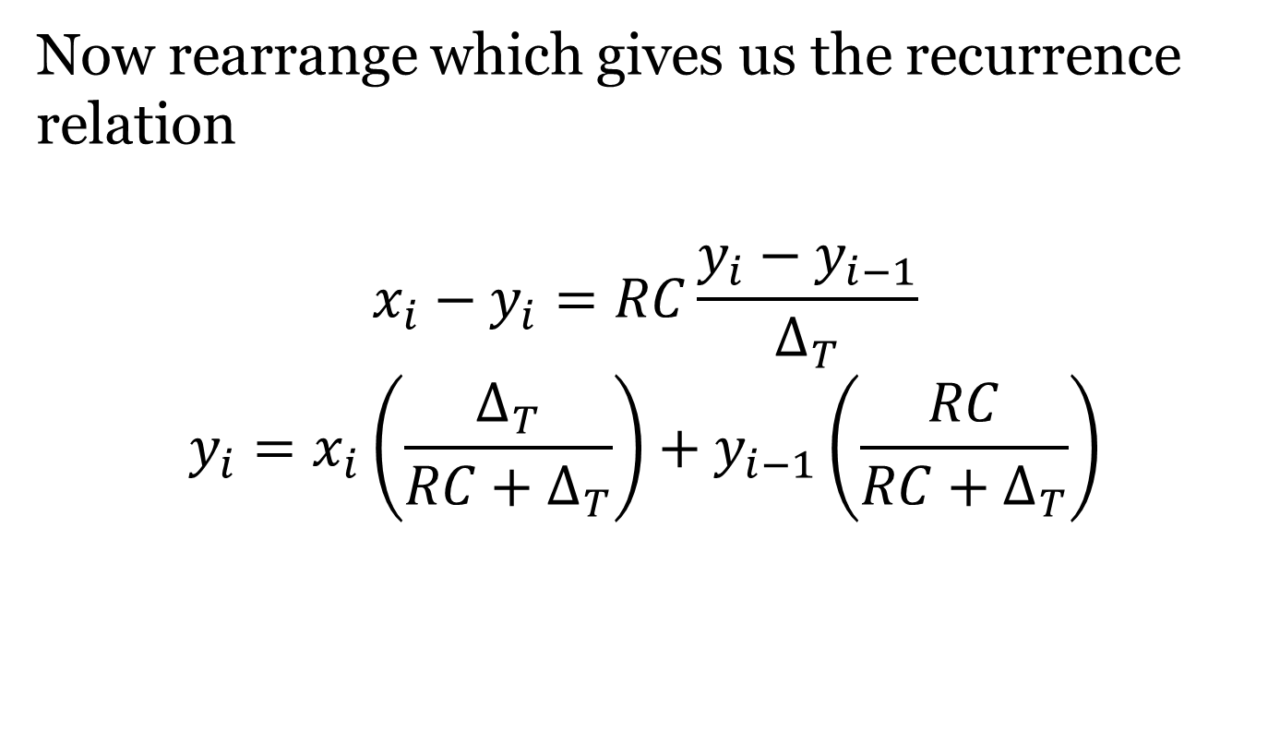
Theory on operation
Now rearrange which gives us the recurrence relation
$$x_{i}−y_{i}=RC\frac{y_{i}−y_{i−1}}{∆_{T}}$$
$$y_{i}=x_{i}\left(\frac{∆_{T}}{RC+∆_{T}}\right)+y_{i−1}\left(\frac{RC}{RC+∆_{T}}\right)$$

Slide 67
Software Defined Radio
N200 Specs
Ettus USRP N200 Unit
Up to 50 MHz BW on RX
1 Gbps interface
DBSRX2 Daughter board
800 MHz to 2350 MHz receive
We listen at 1.4 GHz
Noise Figure of 5 dB

Slide 68
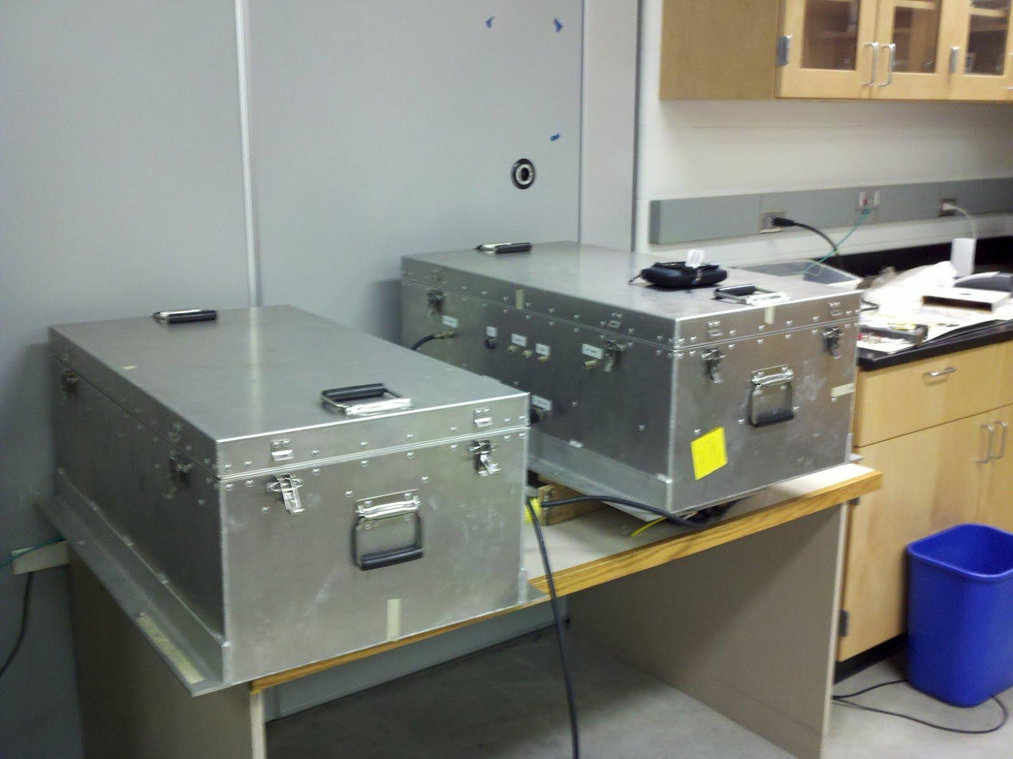
Software Defined Radio

Slide 69
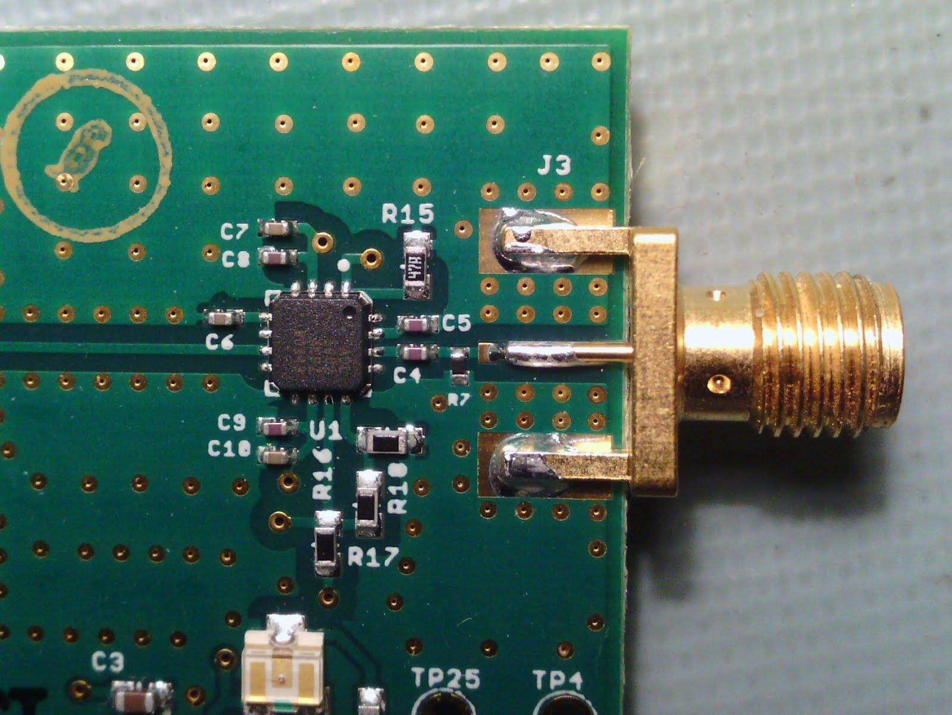
Square Law detector
Analog Devices ADL5902 Square-law detector

Slide 70
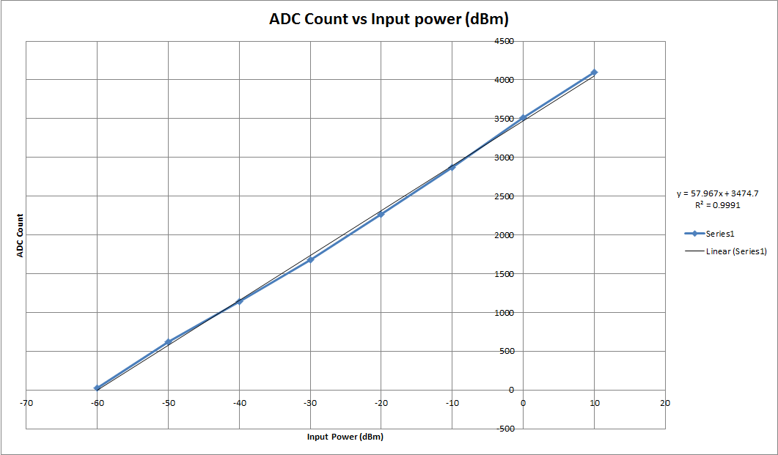
Square Law detector
Tested linearity of the square law detector

Slide 71
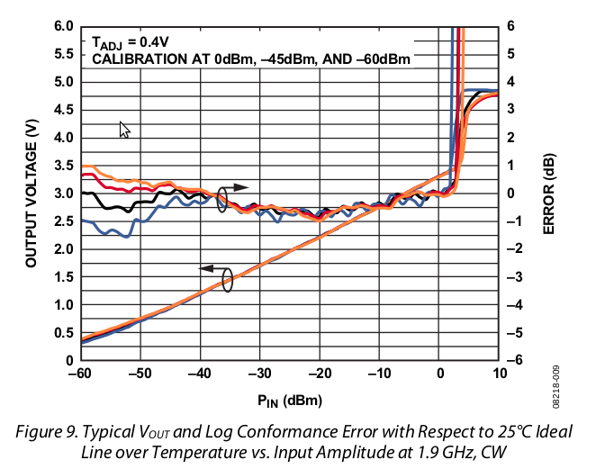
Square Law detector
Analog Devices ADL5902 Square-law detector

Slide 72
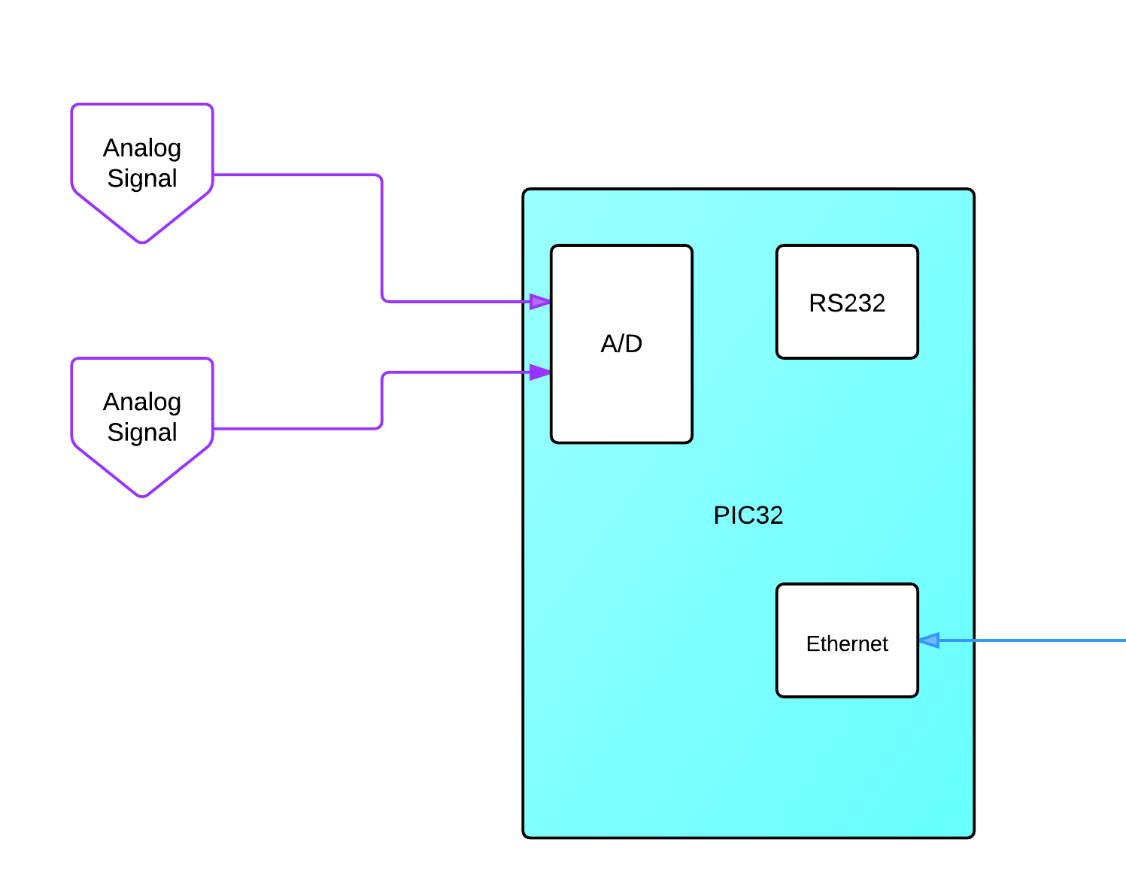
EE 518 Lab
The first “real” test of the square-law detector
ADL5902 measured RF power
Analog signal sent to PIC32 A/D converter
10-bit resolution
Sample rate ~ 100 kHz
PIC32 processed and sent A/D values
Used xBee to send to laptop

Slide 73
Research Infrastructure
Current RF Front End
~ NF of 3.67 dB (~ 385 K)
This includes antenna and all filters and LNAs
Data provided by University of Michigan
Total amplification of 71.4 dB
Also note, the Power Divider will add another ~21 K to the system

Slide 74
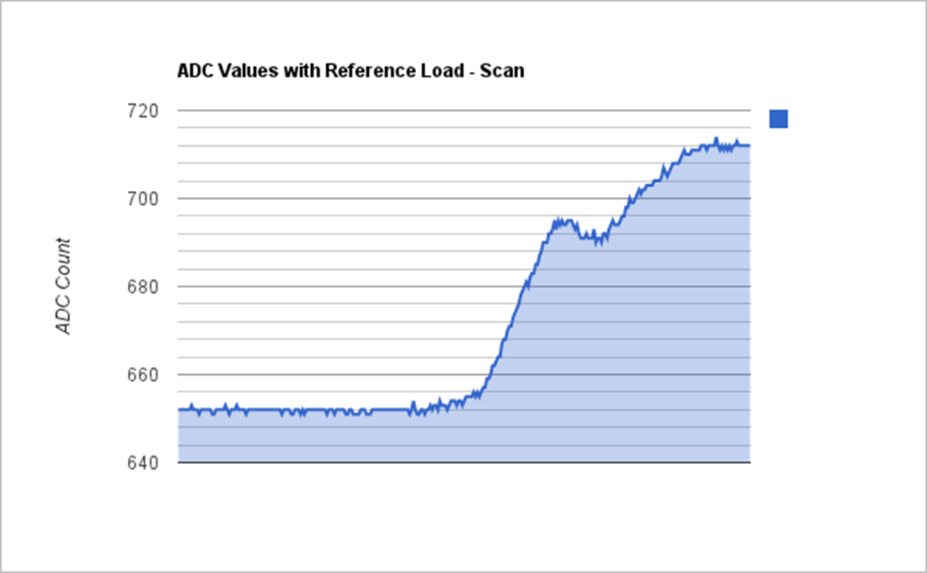
EE 518 Lab

Slide 75
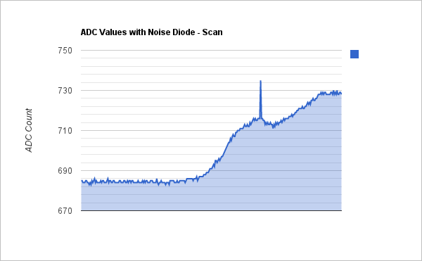
EE 518 Lab

Slide 76
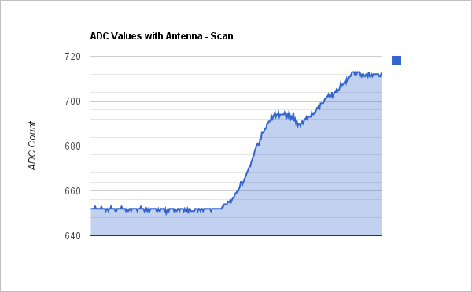
EE 518 Lab

Slide 77
EE 518 Lab
Results – N200

Slide 78
EE 518 Lab
Results – N200
As seen in the video, there is a problem with the RF Front end
It seems to change as the physical radiometer rotates
In addition it is clear that something is creating a signal in the RF chain
We currently think this is due to a faulty LNA(s)
This…is not a good thing
Further investigation is required, but is outside the scope of this thesis

Slide 79
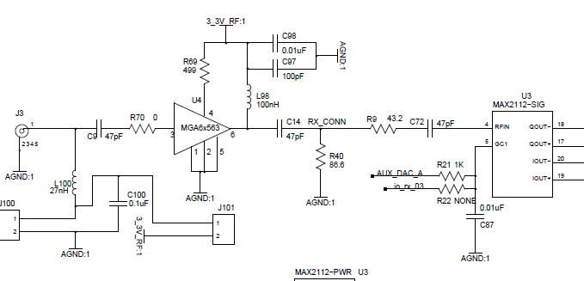
Research Infrastructure
RF Signal fed into DBSRX2 daughter cards
Up to 2 may be installed

Slide 80
Research Infrastructure
MGA6x564
PGA (Programmable Gain Amplifier)
.9 dB NF
Up to 22 dB Gain

Slide 81
Research Infrastructure
MAX2112
Direct conversion IC
Downconverts directly to baseband IQ
Outputs analog I and Q values
Adds an additional ~4 dB Noise Factor

Slide 82
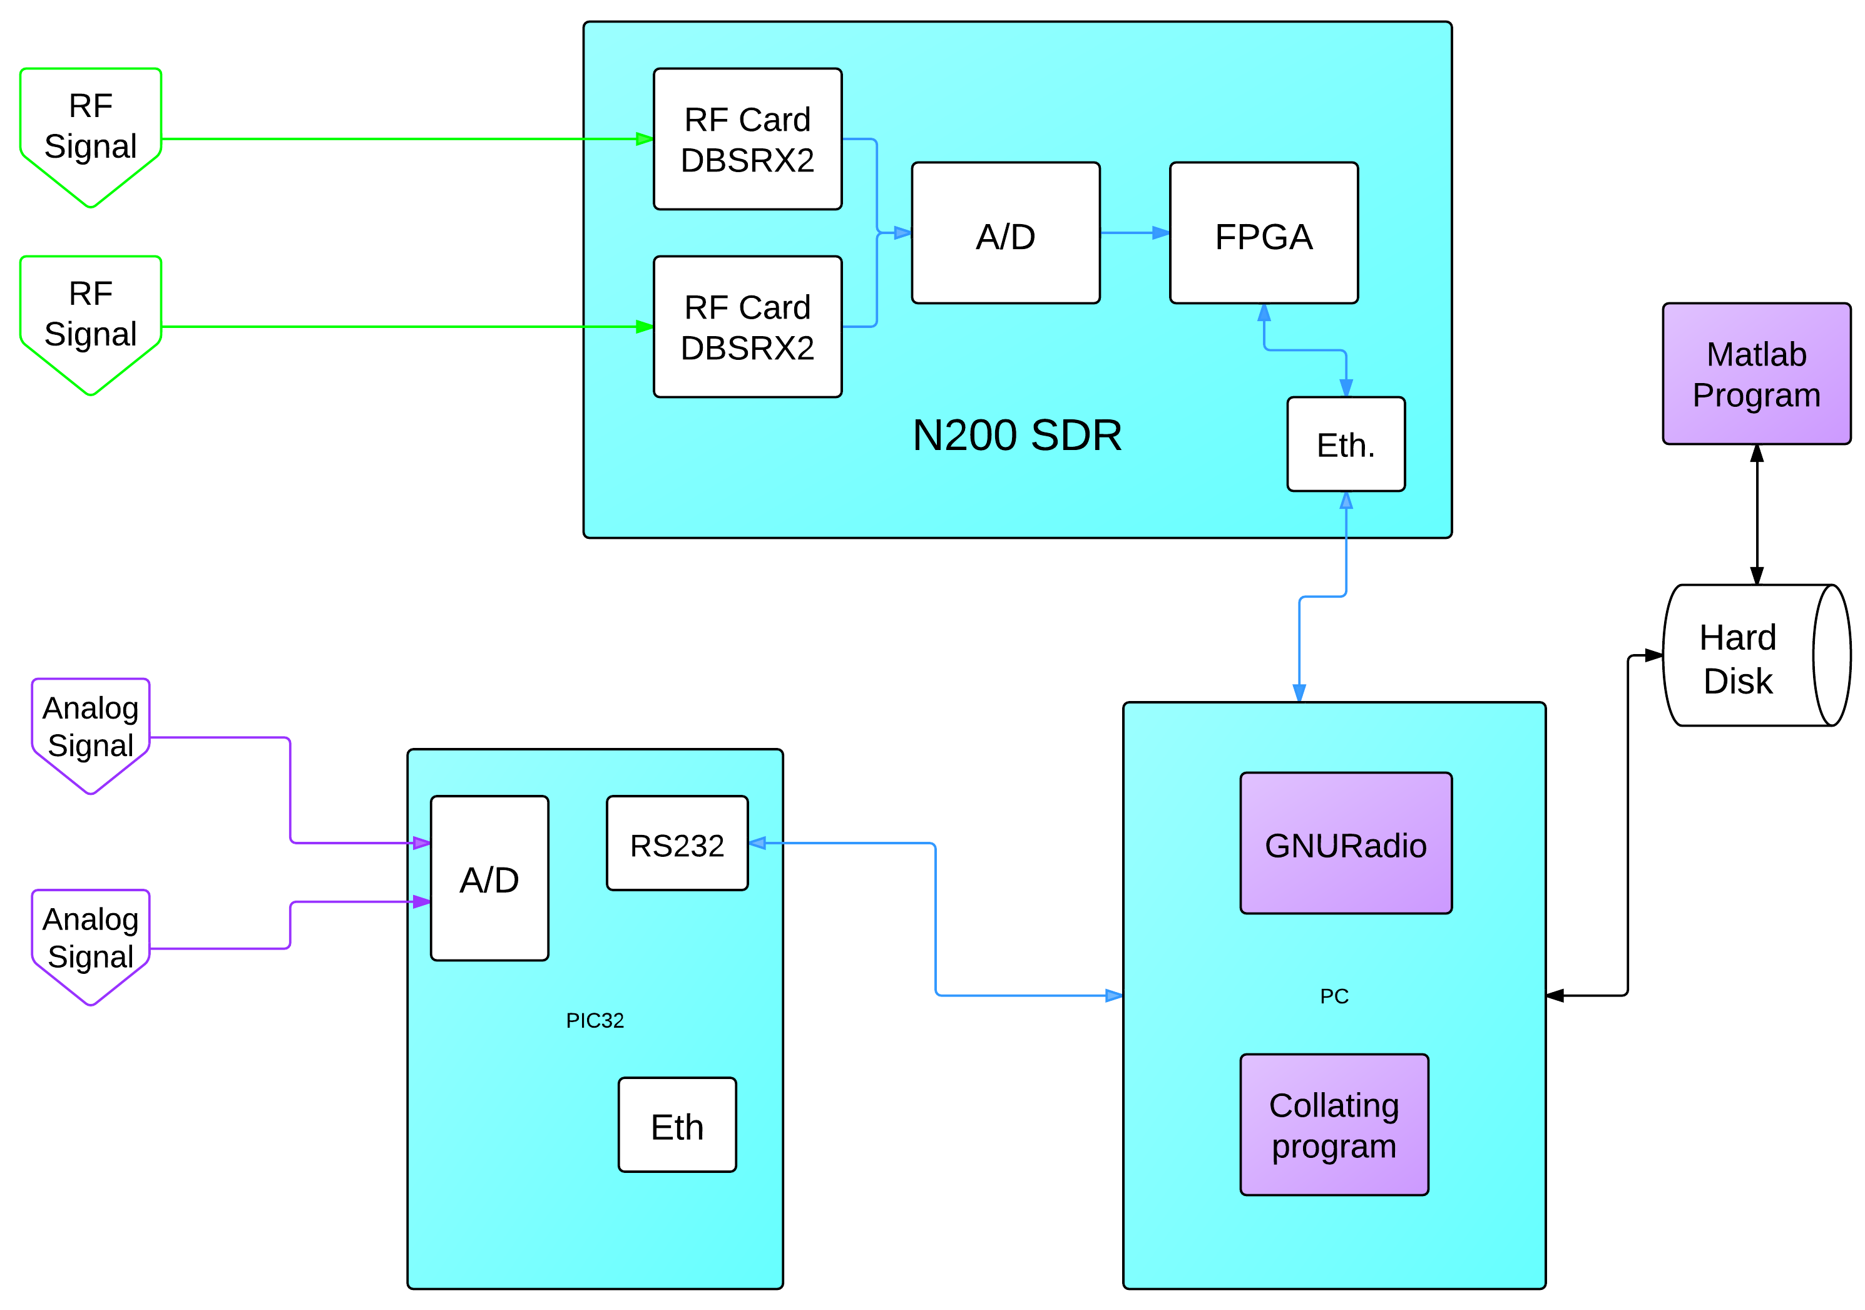
Research Infrastructure
Time stamping

Slide 83
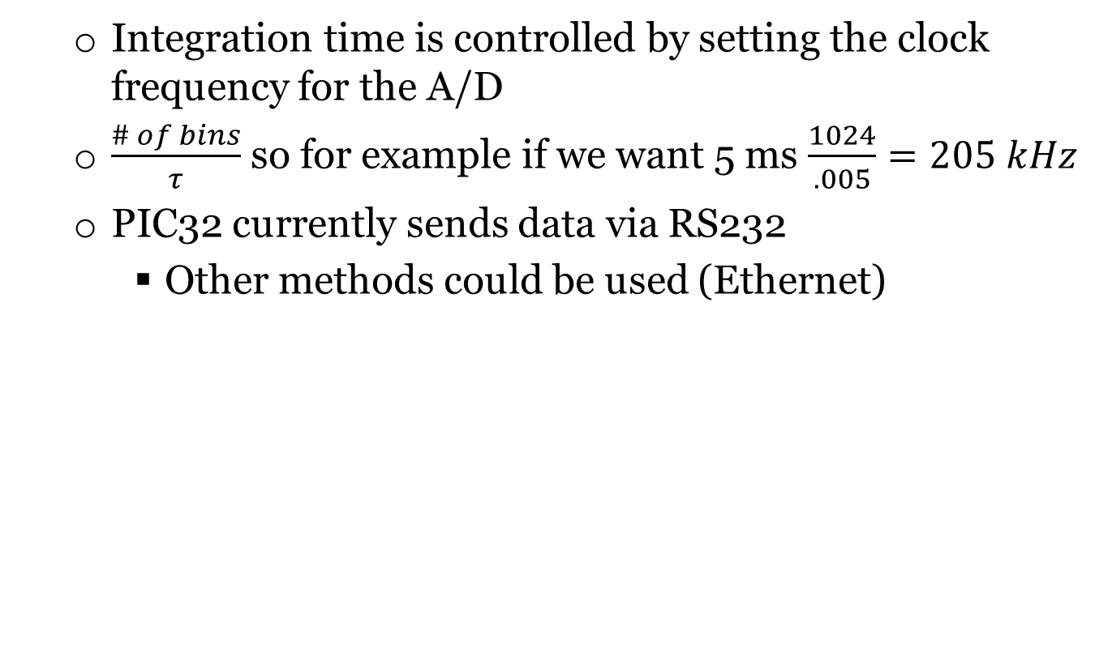
Square-law system
Integration time is controlled by setting the clock frequency for the A/D
$\frac{\# of bins}{τ}$ so for example if we want 5 ms $\frac{1024}{.005}=205 kHz$
PIC32 currently sends data via RS232
Other methods could be used (Ethernet)

Slide 84
Theory on operation
A square-law detector is usually a diode
In software, we simply model this as a square function, why?

Slide 85
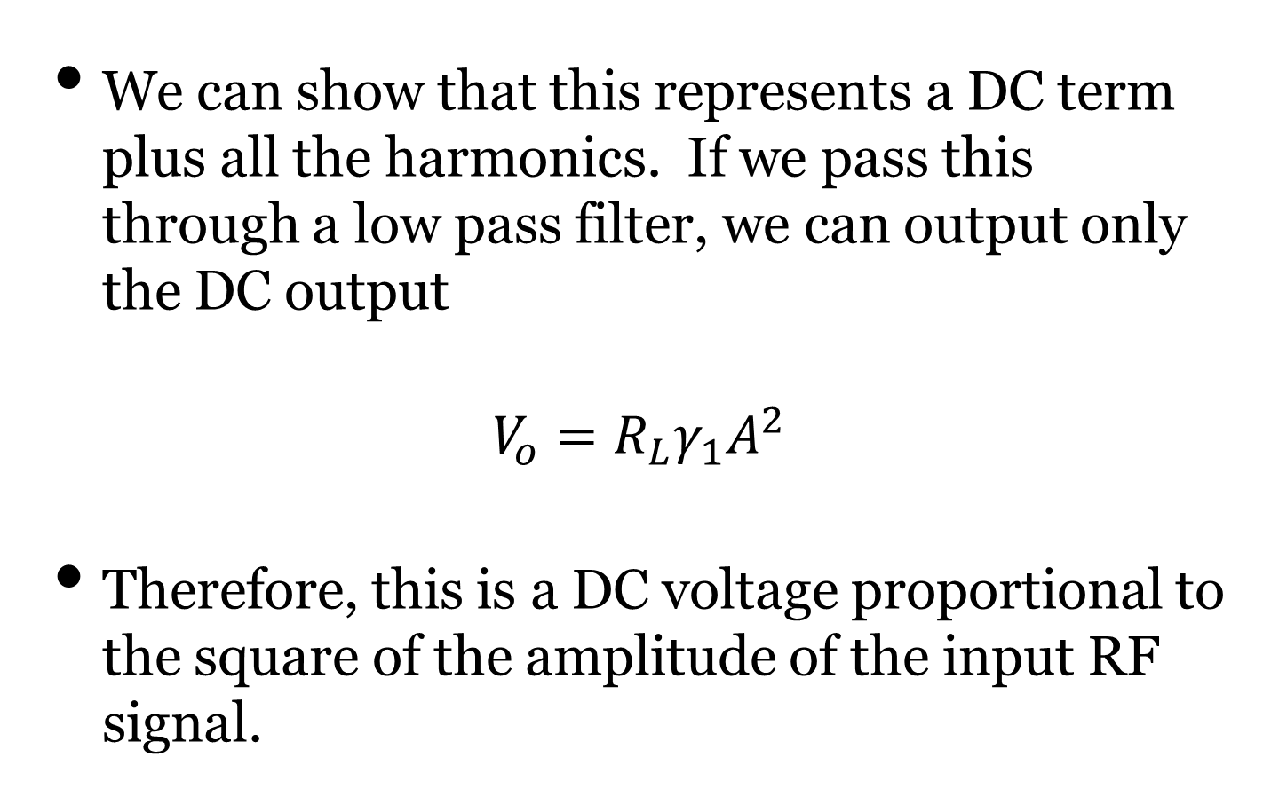
Theory on operation
We can show that this represents a DC term plus all the harmonics. If we pass this through a low pass filter, we can output only the DC output
$$V_{o}=R_{L}γ_{1}A^{2}$$
Therefore, this is a DC voltage proportional to the square of the amplitude of the input RF signal.

Slide 86
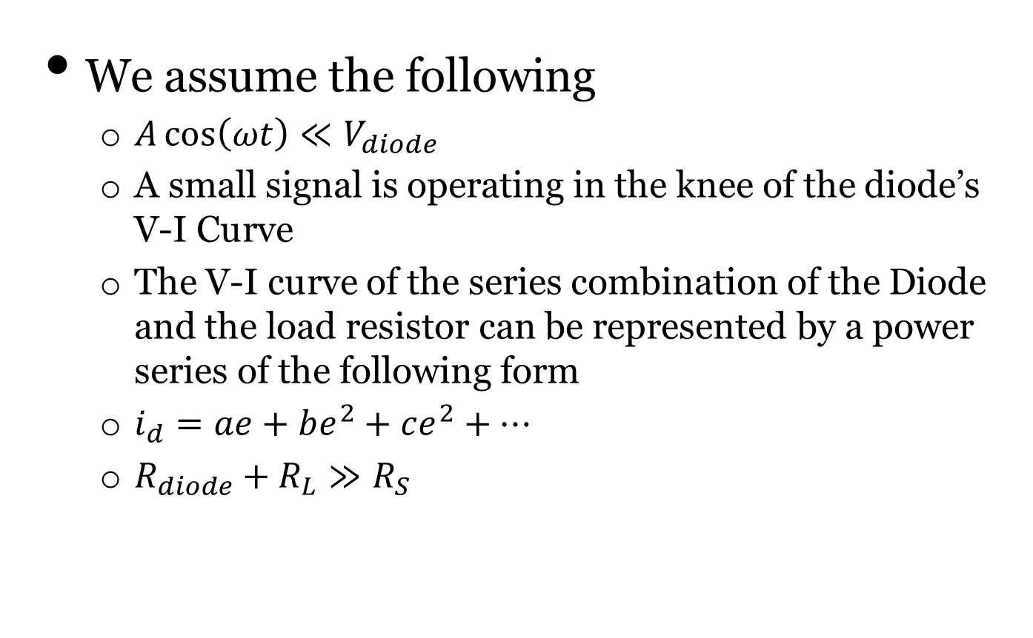
Theory on operation – X^2
We assume the following
$A\cos\left(ωt\right)≪V_{diode}$
A small signal is operating in the knee of the diode’s V-I Curve
The V-I curve of the series combination of the Diode and the load resistor can be represented by a power series of the following form
$i_{d}=ae+be^{2}+ce^{2}+⋯$
$R_{diode}+R_{L}≫R_{S}$

Slide 87
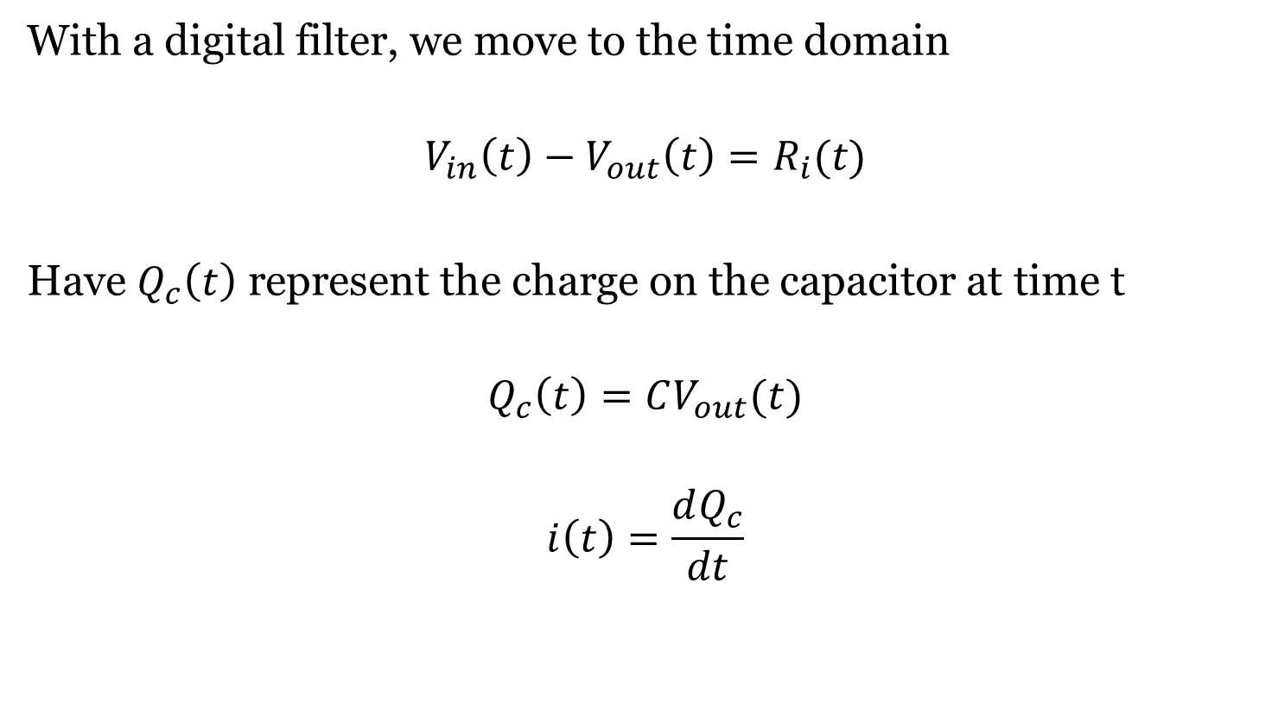
Theory on operation
With a digital filter, we move to the time domain
$$V_{in}\left(t\right)−V_{out}\left(t\right)=R_{i}(t)$$
Have $Q_{c}\left(t\right)$ represent the charge on the capacitor at time t
$$Q_{c}\left(t\right)=CV_{out}(t)$$
$$i\left(t\right)=\frac{dQ_{c}}{dt}$$

Slide 88
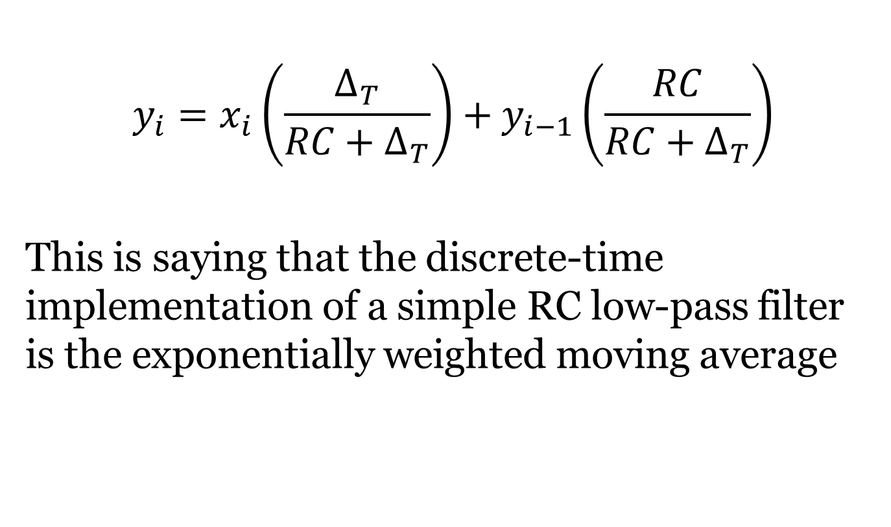
Theory on operation
$$y_{i}=x_{i}\left(\frac{∆_{T}}{RC+∆_{T}}\right)+y_{i−1}\left(\frac{RC}{RC+∆_{T}}\right)$$
This is saying that the discrete-time implementation of a simple RC low-pass filter is the exponentially weighted moving average

Slide 89
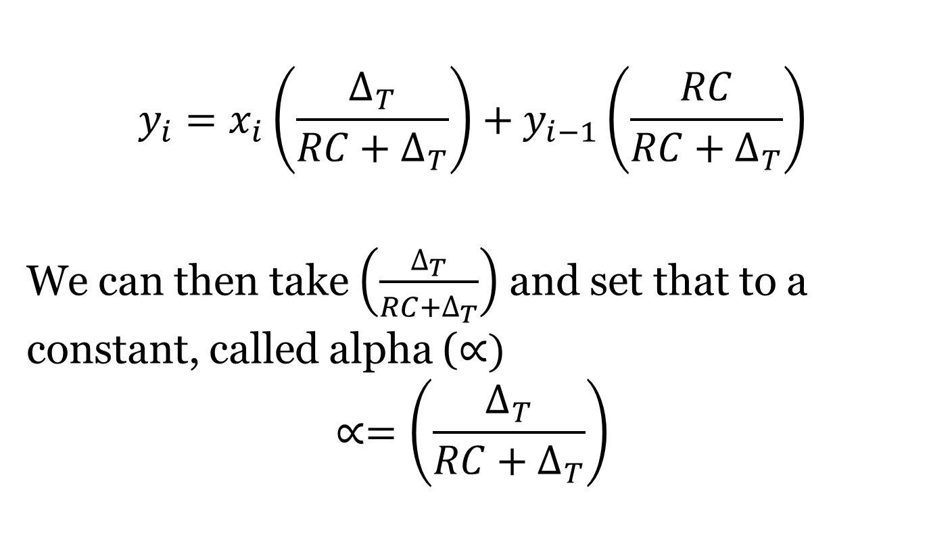
Theory on operation
$$y_{i}=x_{i}\left(\frac{∆_{T}}{RC+∆_{T}}\right)+y_{i−1}\left(\frac{RC}{RC+∆_{T}}\right)$$
We can then take $\left(\frac{∆_{T}}{RC+∆_{T}}\right)$ and set that to a constant, called alpha ($∝)$
$$∝=\left(\frac{∆_{T}}{RC+∆_{T}}\right)$$

Slide 90
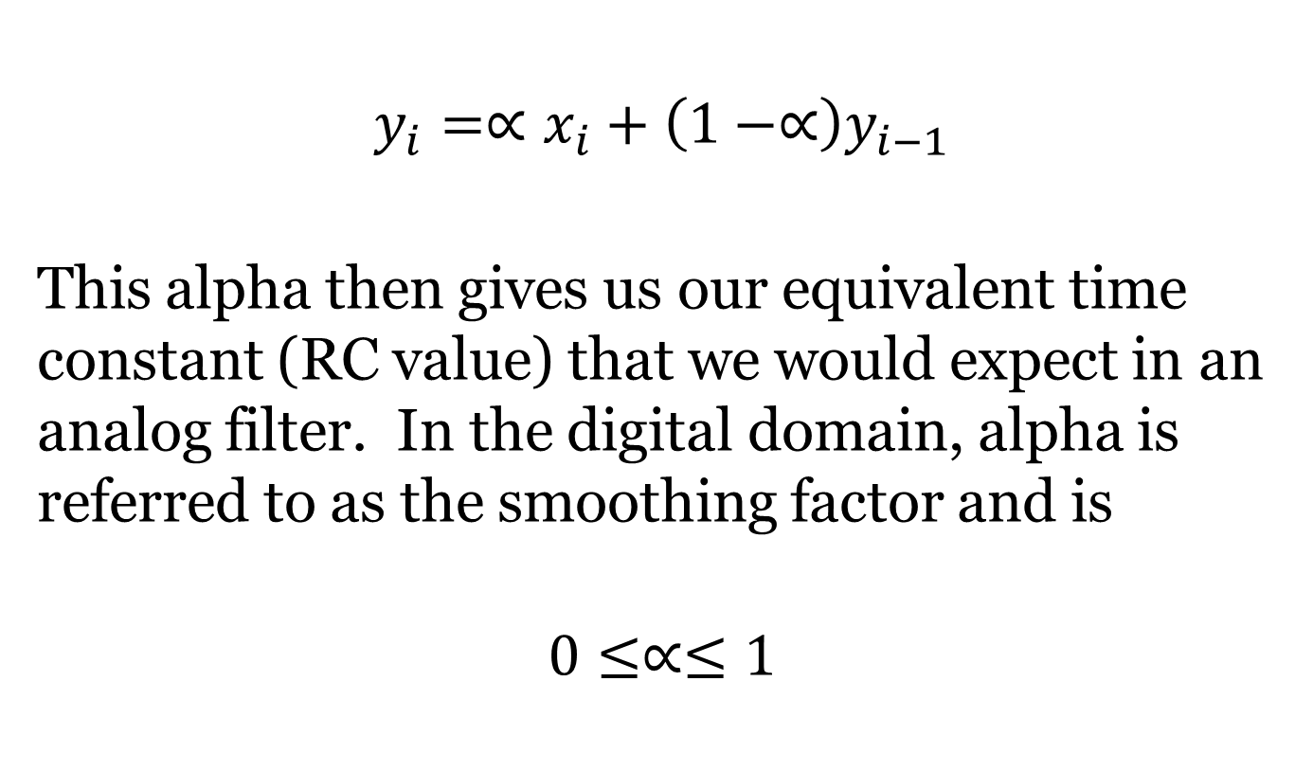
Theory on operation
$$y_{i}=∝x_{i}+\left(1−∝\right)y_{i−1}$$
This alpha then gives us our equivalent time constant (RC value) that we would expect in an analog filter. In the digital domain, alpha is referred to as the smoothing factor and is
$$0≤∝≤1$$

Slide 91
EE 518 Lab
Results – N200
After the initial lab, the N200 was hooked up to record a sample
20 MHz sample rate
Stored to laptop HDD
Viewed later after sample recorded

Slide 92
EE 518 Lab
Results – N200

Slide 93
EE 518 Lab
Conclusion
Lab was a “success” in that data was recorded
Our original assumption that the RF front end was “ok” appears to be incorrect
While the data was inconclusive and not what we expected, it validated using a SDR to do further analysis on the signal

Slide 94
EE 518 Lab
Results
Good news
Data was recorded and has some consistency
Noise diode is clearly working
Bad news
Does not appear we are switching sources
Odd spike in Noise Diode data
Something is not quite right with the RF Front end

Slide 95
EE 518 Lab
Results
Data was inconclusive
One hypothesis is the RF switch did not function as intended
Data did not “match up” to what was expected
Changes however were measured
High confidence that square-law detector and PIC32 did their job
Data recorded with the SDR shed some light on some issues

Slide 96
Infrastructure Testing
Simulink file
Created to help in determine system noise temp.
Simulink has this built into SimRF
Unfortunately ISU does not have a license for this
Created simple “m-blocks”

